Slide 1
Concept Generation and Evaluation
Winiecki Renewable Energy Project
Nicholis Santana, Issac Granados, Michael Horn, Garrett Cornelius
ME 476C
Dr. Carson Pete
Northern Arizona University
Department of Mechanical Engineering

Slide 2
Project Description
Background:
Private party off grid cabin to be constructed by Winiecki family
Construction plans are already in place
Site location established
APS power will be connected
Looking for a Hybrid Solar System
Project Goals:
Analyze solar photovoltaic systems for off grid application
Model estimated energy load / consumption of the Winiecki off grid cabin
Test energy demands of cabin
Optimize solar system for maximum efficiency
Implement and install selected solar design in person
Nicholis Santana
04/05/23
Renewable Energy Project

Slide 3
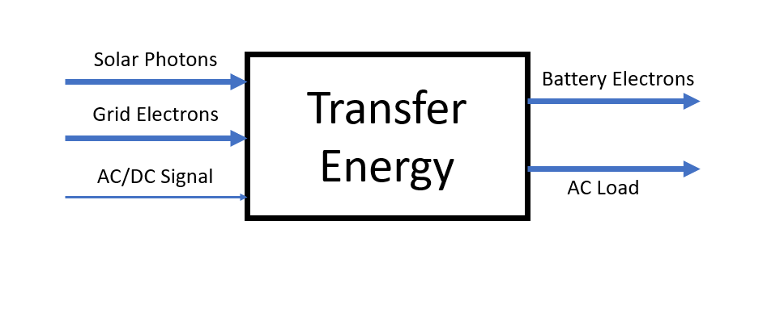
Black Box Model
A PV system, in its simplest form, is designed to transfer energy.
A Hybrid System takes power from the sun and the grid to provide AC power to the house
Figure 1: Black Box Model
Nicholis Santana
04/05/23
Renewable Energy Project

Slide 4
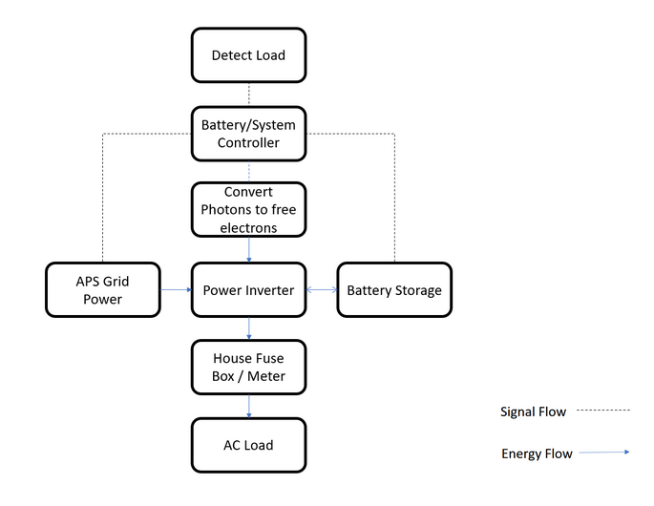
Functional Decomposition
Function Chain for a Hybrid system
System can provide power from:
Grid Power
Solar Generation
Battery Storage
Decomposition simplifies connections and breaks design into smaller pieces
Figure 2: Function Decomposition Flowchart
Nicholis Santana
04/05/23
Renewable Energy Project

Slide 5
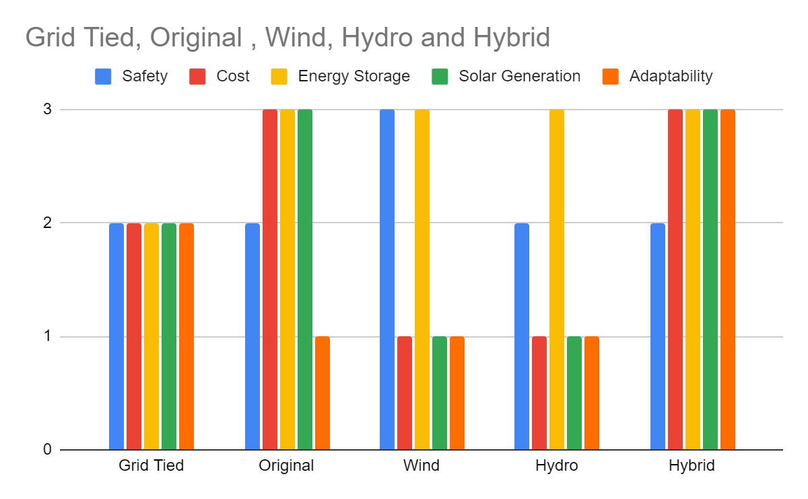
Concept Generation
Generation Process
Customer Requirements
Pre-existing Renewable Sources
Team criteria
Figure 3: Renewable Energy Graph
Issac Granados
04/05/23
Renewable Energy Project

Slide 6
Pugh Chart
Figure 4: Pugh Chart
Issac Granados
04/05/23
Renewable Energy Project

Slide 7
Concept Variations
Final Full System
Fixed
Trina Tallmax
Kong Elite
Subsystem
Tilt Angle
Fixed/Automatic Variable
Panel Types
Q-Peak/Trina
Battery Types
Kong/Mammoth
Issac Granados
04/05/23
Renewable Energy Project

Slide 8
Full System Designs
Design 1
Panel Type: Q.Peak 365
Warranty, Micro Inverters
Battery System: Fortress eVault
Safety, Space
Tilt Angle: Automatic Variable
Efficiency, Generation
Design 2
Panel Type: Trina Tallmax TSM-DE15V
Cost, Efficiency
Battery System: Kong Elite
Cost, Expectation
Tilt Angle: Fixed
Cost, Durability
Issac Granados
04/05/23
Renewable Energy Project

Slide 9
Concept Evaluation
Customer Requirements:
Safety
Off Grid Capabilities with no feedback
Energy Storage
Energy Generation
Minimized Cost
Designs Selected for Recommendation:
Design 1
Design 2
Comparison:
Differences in designs are among individual components only
Batteries and solar panels are the major differences between designs
The system layout, location, construction will remain constant
Both designs meet customer requirements
Design 2 may be slightly cheaper
Final design is ultimately dependent upon client’s energy needs and is subject to change
Michael Horn
04/05/23
Renewable Energy Project

Slide 10
Decision Matrix
Figure 5: Final Decision Matrix
Michael Horn
04/05/23
Renewable Energy Project

Slide 11
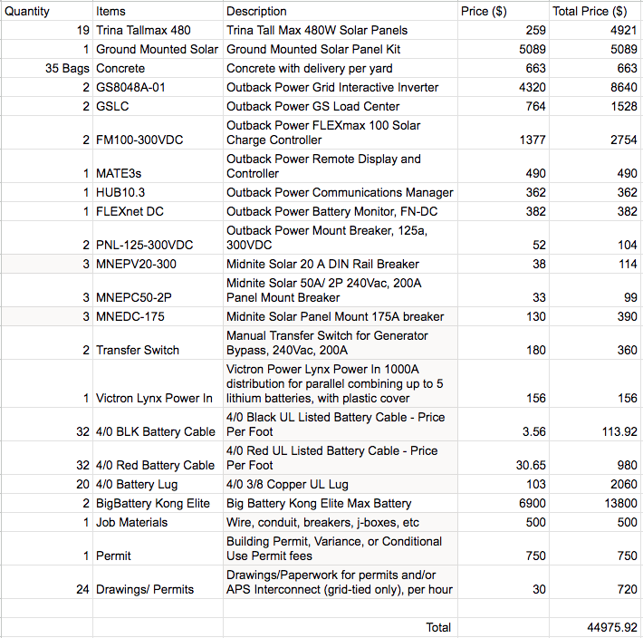
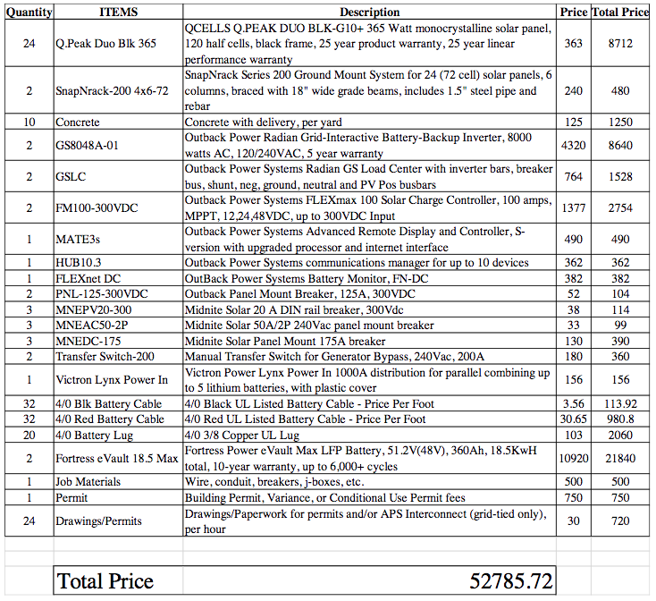
Budget Planning - Dependent on Client Needs
Michael Horn
04/05/23
Renewable Energy Project
Figure 6: Design 2 BOM Figure 7: Design 1 BOM (Original Design)

Slide 12
Looking Ahead
Schedule / Gannt Chart
Prototyping
Energy Model Progress
Nicholis Santana
04/05/23
Renewable Energy Project

Slide 13
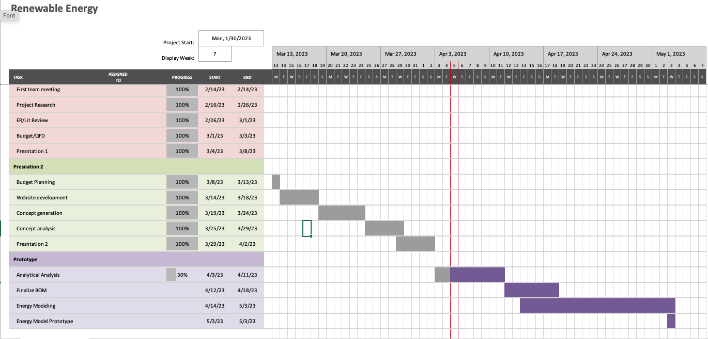
Gannt Chart
Nicholis Santana
04/05/23
Renewable Energy Project
Figure 8 : Team Gannt Chart

Slide 14
Prototyping
Renewable Energy Lab has similar components to our planned system
“Prototyping” will be the examination and understanding of the pre-existing system
Gaining familiarity with functions and connections for Inverters, Panels, Controllers etc.
The team will gain knowledge from Dr. Pete to help with the install process for next semester
Nicholis Santana
04/05/23
Renewable Energy Project

Slide 15
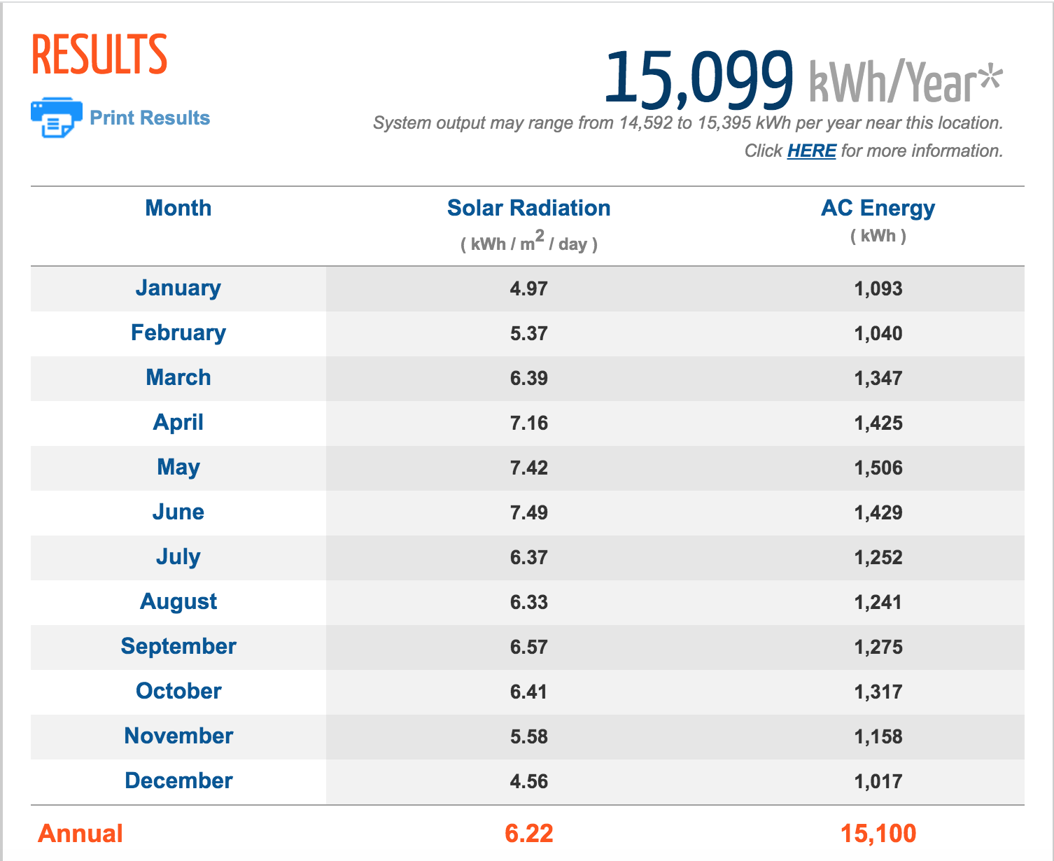
NREL PVWatts Calculator
NREL’s Solar Production Calculator
Input :
Location, System Size, Tilt and Azimuth Angles
Output :
Expected kWh production by month/year
Image shows kWh results for 9 kW system with optimized angles at customer’s location
Garrett Cornelius
04/05/23
Renewable Energy Project
Figure 9 : PVWatts Output
Photo Reference : [1] https://pvwatts.nrel.gov/

Slide 16
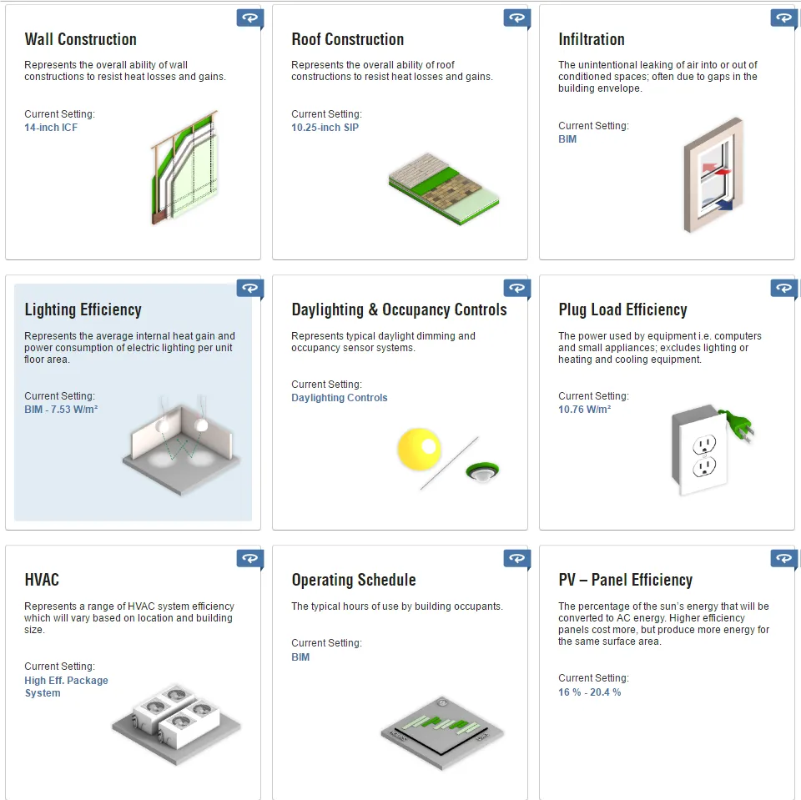
Energy Model Progress
Chosen Design Tool: Autodesk Revit
Autodesk Insight powered by EnergyPlus engine
Garrett Cornelius
04/05/23
Renewable Energy Project
Figure 10: Revit Solar Projection
Photo References: [2] https://www.autodesk.com/products/insight/overview
Figure 11: Insight Tool Output

Slide 17
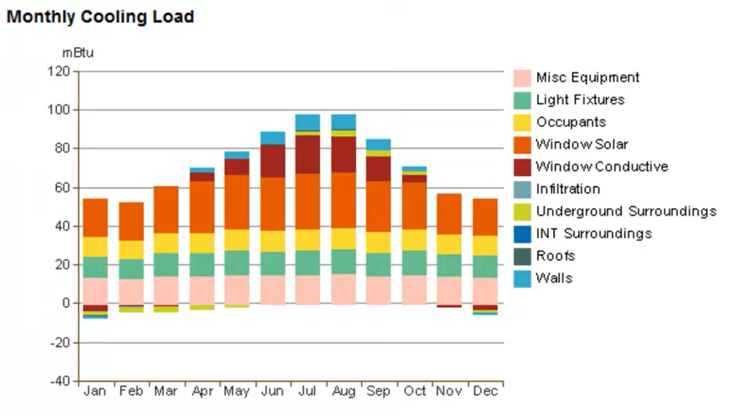
Expected Data Outputs:
Building Performance Factors
Life Cycle Energy Use/Costs
Annual Energy Use Breakdown (HVAC, Lighting, Appliances, etc.)
Potential energy saving recommendations
Monthly/ Annual Load Charts
Energy Requirements (Goal of the Energy Model)
Figure 12: Insight Monthly Cooling Load Output
Garrett Cornelius
04/05/23
Renewable Energy Project
Photo References: [2] https://www.autodesk.com/products/insight/overview

Slide 18
References
[1] https://www.autodesk.com/products/insight/overview
[2] https://www.autodesk.com/products/insight/overview
Garrett Cornelius
04/05/23
Renewable Energy Project

